Slide 1


Hii, Iam Siddhika
Welcome to Power BI Series
Part -22

Slide 2

Today Content
I’m soo Excited.
Are you ready guys?
Meet DAX
DAX SYNTAX
DAX OPERATORS

Slide 3


DAX SYNTAX
Total Quantity = SUM(Transactions[quantity])
Have you got it?
Referenced TABLE NAME
Referenced COLUMN NAME
MEASURE NAME:
In Power BI, measure names are like titles, always inside brackets, like [Total Quantity]. This helps Power BI know you're talking about a measure. And hey, you can even put spaces in measure names to make them clearer!
FUNCTION NAME:
Calculated columns don’t always use functions, but measures do:
In a Calculated Column,
=Transactions[quantity] returns the value from the quantity column in each row (since it evaluates one row at a time)
This is a “fully qualified” column, since it’s preceded by the table name.
NOTE: Table names with spaces must be surrounded by single quotes:
In a Measure
,=Transactions[quantity] will return an error since Power BI doesn’t know how
to translate that as a single value – you need some sort of aggregation
Without a space: Transactions[quantity] •
With a space:‘Transactions Table’[quantity]

Slide 4


Check this
TIP:
Column references use fully qualified names (i.e. ’Table’[Column])
Measure references just use the measure name (i.e. [Measure]) and
can be called by typing an open square bracket “ [ “

Slide 5
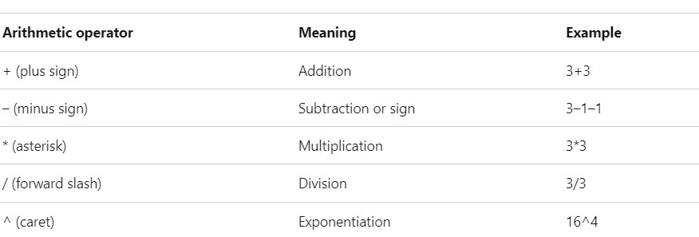


DAX OPERATORS
Arithmetic operators
check this?

Slide 6
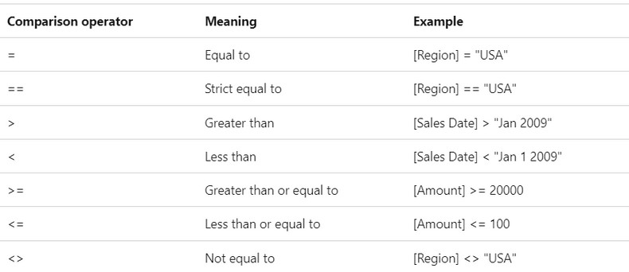

Comparison operators
learn it?

Slide 7
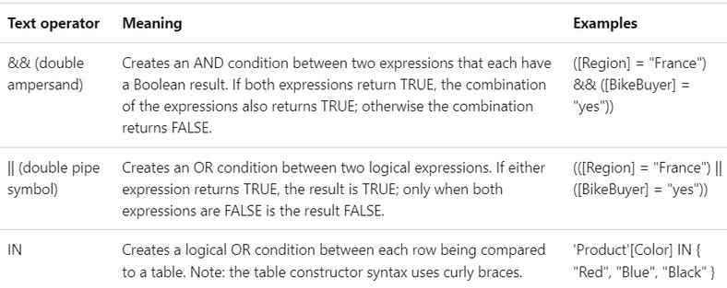

Logical operators
Check this

Slide 8


Thank you for joining me today to learn about Part -22 of Power BI!
Remember, Learning DAX is key to unlocking the full potential of Power BI for insightful reporting and visualization.
Stay tuned for more insights and tips on Power BI in our next Series.
Follow
Siddhika Shah

